Slide 1

Objectives
In this session, you will learn to:
  Identify the program flow of an application by using call graph
Notes:
Share the objectives with the students.

Slide 2
Activity: Performing Event-Based Sampling – 2
Problem Statement:
  Jim has developed an application, Create_List, in C#. However, on implementing a delete operation on the list, he finds that his application performs slowly. Therefore, Jim decides to analyze the performance of the application using the event-based sampling (EBS) feature of VTune Performance Analyzer. He wants to use the new integration feature of VTune Performance Analyzer with Microsoft Visual Studio 2005. Help Jim do to analyze the performance of the application using VTune Performance Analyzer.
Notes:
To demonstrate this activity, you can use the data files provided at the following locations:
TIRM → Datafiles for Faculty → Chapter04 → Activity02 → Create list.zip
Create list.zip file contains the optimized and the unoptimized codes. The faculty should first show the demonstration of the unoptimized code. After analyzing the sampling results, the faculty should again run the activity using the optimized code. This would enable the students comparing the sampling results between the optimized and the unoptimized code.

Slide 3
Activity: Performing Event-Based Sampling – 2 (Contd.)
Solution
  To analyze the performance of the application using EBS, you need to perform the following tasks:
    Configure EBS through the integration feature of VTune Performance Analyzer with Microsoft Visual Studio 2005.
    Analyze sampling results.
Notes:
To demonstrate this activity, you can use the data files provided at the following locations:
TIRM → Datafiles for Faculty → Chapter04 → Activity02 → Create list.zip
Create list.zip file contains the optimized and the unoptimized codes. The faculty should first show the demonstration of the unoptimized code. After analyzing the sampling results, the faculty should again run the activity using the optimized code. This would enable the students comparing the sampling results between the optimized and the unoptimized code.

Slide 4
Activity: Performing Event-Based Sampling – 3
Problem Statement:
  Jim Lewis, a software developer, is working with Super Technology. He is required to develop a gaming application in C#. He first decides to design the start page of the gaming application. According to the requirement, the start page should be very attractive. To do so, he uses various labels that change their color at runtime. However, on execution, the application performs very slowly. Therefore, he decides to analyze his code using the event-based sampling (EBS) feature VTune Performance Analyzer. Help Jim accomplish his task.
Notes:
To demonstrate this activity, you can use the data files provided at the following locations:
TIRM → Datafiles for Faculty → Chapter4 → Activity3 → Game.zip
Game.zip file contains the optimized and the unoptimized codes. The faculty should first show the demonstration of the optimized code. After analyzing the sampling results, the faculty should again run the activity using the optimized code. This would enable the students comparing the sampling results between the optimized and the unoptimized code.
Tell the students that improper use of threads can degrade the performance of your application. Threads should be used judiciously in the application. In the preceding activity, many threads have been created in the unoptimized code. These threads change the color of various labels at runtime. However, in the optimized code, the same work has been implemented without using threads.

Slide 5
Activity: Performing Event-Based Sampling – 3 (Contd.)
Solution
  To analyze the performance of the gaming application using EBS, you need to perform the following tasks:
    Configure EBS using the Advanced Activity Configuration wizard.
    Analyze sampling results.
Notes:
To demonstrate this activity, you can use the data files provided at the following locations:
TIRM → Datafiles for Faculty → Chapter04 → Activity02 → Create list.zip
Create list.zip file contains the optimized and the unoptimized codes. The faculty should first show the demonstration of the unoptimized code. After analyzing the sampling results, the faculty should again run the activity using the optimized code. This would enable the students comparing the sampling results between the optimized and the unoptimized code.

Slide 6
Using Call Graphs
The call graph collector of VTune Performance Analyzer:
  Provides information about the functional flow of an application.
  Enables you obtain information about how many times a function is called from a specific location.
  Enables you to identify the amount of time spent on each function when executing its code.
Notes:
The call graph feature of VTune Performance Analyzer provides function calling sequence and function timing information of an application.
The call graph help you determine:
Which function has the longest execution time and what functions are calling it?
Which execution path in your code is taking the most time?
Which functions in your application are getting called?
Also, ask students what is meant by instrumentation?
Explain that Instrumentation is a technique used for measurement and it means inserting functions to see what time it is entering and leaving and which function is called.
The following example shows that user has inserted the variables count1 and count 2 for instrumentation. This will measure the number of times a particular line is executed.
Max = 0;
for (p = head; p; p = p->next)
{
count1++;
if (p->value > max)
{
count2++;
max = p->value;
}
}

Slide 7
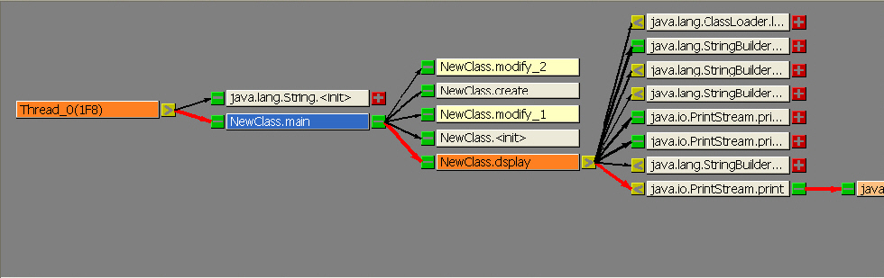
Identifying Critical Paths Using Call Graphs
A call graph collector enables you to identify critical paths in the application.
The critical path is the most time-consuming path in the call sequence of an application that originates from the root function.
In a call graph, the critical path is displayed with a thick red edge and starts from the most time-consuming function or thread.
Notes:
Explain the students that they can change the color palette for the graph view. To change the color palette for the graph view, asks the students to explore the Vtune Help.
Ask students if you can specify the time for profiling in call graph as is done in sampling?
Ans: Yes, you can specify time in call graph.
Also, ask how can you draw inferences about hotspots in a call graph as is done in sampling?
Ans: To analyze the hotspot functions, you can view the critical path in a call graph view.

Slide 8
Identifying Critical Paths Using Call Graphs (Contd.)
VTune Performance Analyzer displays the results of the call graph in three, synchronized views:
  Graph view
  Call list view
  Functional summary
Using the three views, you can identify the most
time-consuming function in a call sequence.
Notes:
Tell the students about the different view in a call graph.

Slide 9
Identifying Critical Paths Using Call Graphs (Contd.)
Graph View:
  The graph view displays the graphical structure of the application that you run in VTune Performance Analyzer.
  The graph view also displays the caller function, the callee function, and time information as seen in the following figure.
  In the preceding figure, the main() function calls various functions such as modify_1(), modify_2(), create(), etc.
Notes:
In this slide, explain the graph view in detail with the help of the diagram.

Slide 10
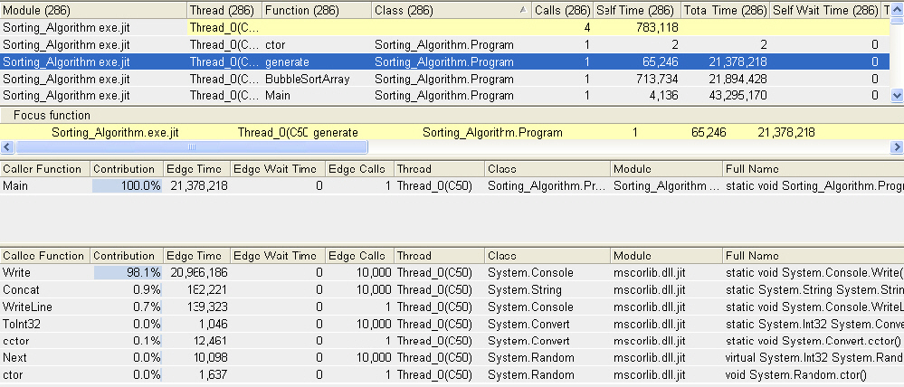
Identifying Critical Paths Using Call Graphs (Contd.)
Call List View:
  It consists of three different sections: focus function, caller function, and callee function.
  It displays information about time and calls of the focus function.
    The focus function is the function that you highlight in the function summary or the graph view.
Notes:
In this slide, explain the call list view to the students.

Slide 11
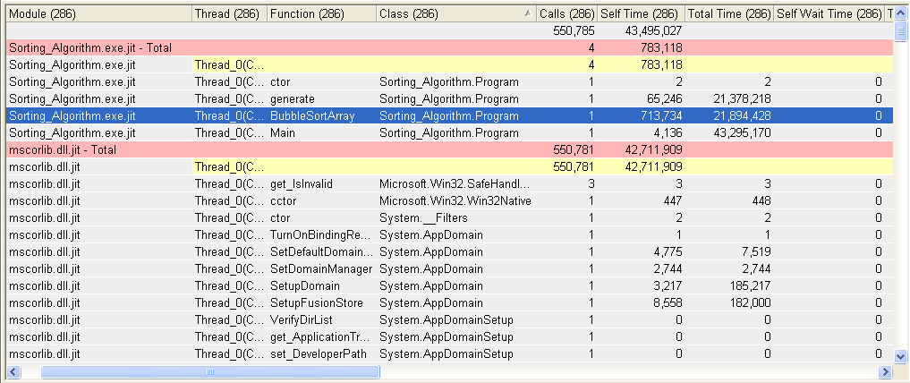
Identifying Critical Paths Using Call Graphs (Contd.)
Function Summary View:
  It displays all the functions that your application calls along with the performance metrics list in tabular format.
Notes:
In this slide, explain the summary view in detail with the help of the diagram.

Slide 12
Identifying Critical Paths Using Call Graphs (Contd.)
The different types of performance metrics displayed in the function summary view are as follows:
  Total time
  Self time
  Total wait time
  Wait time
  Calls
►
Time spent between the start of the execution of a function and its termination.
►
Time spent inside a function. However, self time does not include the time spent on child functions.
►
Time spent on a function and its child functions when the thread is suspended.
►
Time spent on a function when the thread is suspended. However, the wait time does not include the time spent on the child functions of the function.
►
Number of times a function is called.
Notes:
In this slide, discuss the various types of performance metrics with the help of animations.

Slide 13
Activity: Using Call Graph – 1
Problem Statement:
  Jim has developed a code to sort a large list of numbers, which are generated randomly. However, on execution, he finds that the application is performing very slowly. Therefore, Jim decides to analyze the performance of the application using the call graph feature of VTune Performance Analyzer. Jim wants to know the time taken by each function to execute. He also wants to view the source code of the function taking more time to execute and optimize the application accordingly. Help Jim analyzing the code using the call graph feature of VTune.
Notes:
To demonstrate this activity, you can use the data files provided at the following locations:
TIRM → Datafiles for Faculty → Chapter04 → Activity04 → Sorting Algorithm.zip
Sorting Algorithm.zip file contains the optimized and the unoptimized codes. The faculty should first show the demonstration of the unoptimized code. After analyzing the call graph results, the faculty should again run the activity using the optimized code. This would enable the students comparing the results between the optimized and the unoptimized code.
In the preceding activity, the unoptimized code sorts a huge list of numbers using the bubble sort algorithm. In this case, the function that sorts the list of numbers consumes a lot of time. This is because bubble sort algorithm is suitable for sorting a small list of numbers. Therefore, to optimize the application, a different algorithm should be used.
In this case, the problem is solved by using quick sort algorithm for sorting the huge list of numbers. This consumes lesser amount of time in sorting the list as compared to sorting the list using the bubble sort algorithm. Faculty should demonstrate the same with the help of the optimized code for this activity.

Slide 14
Activity: Using Call Graph – 1 (Contd.)
Solution
  To analyze the performance of the application using call graph, you need to perform the following tasks:
    Configure call graphs using the Call Graph Configuration wizard.
    Analyze call graph results.
    Analyze the time taken by each function to execute.
Notes:
To demonstrate this activity, you can use the data files provided at the following locations:
TIRM → Datafiles for Faculty → Chapter04 → Activity02 → Create list.zip
Create list.zip file contains the optimized and the unoptimized codes. The faculty should first show the demonstration of the unoptimized code. After analyzing the sampling results, the faculty should again run the activity using the optimized code. This would enable the students comparing the sampling results between the optimized and the unoptimized code.

Slide 15
Summary
In this session, you learnt that:
  The call graph collector of VTune Performance Analyzer helps you obtain information about the functional flow of an application.
  Using the call graph collector, you can identify the critical path of an application or a module.
  The critical path is the most time-consuming path in the call sequence of an application.
  VTune Performance Analyzer displays the results of the call graph in three different views:
    Graph
    Call list
    Functional summary
Notes:
Summarize the session.

